Slide 1
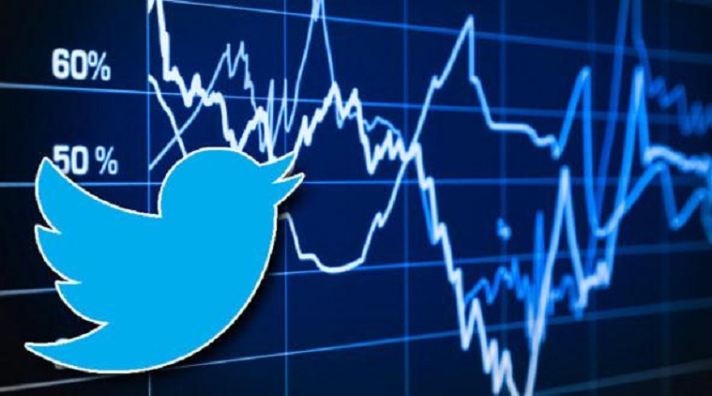
Stock Market Based On Tweets
For POLIMI
Group 6 :
Alejandro Acosta
Diego Martínez
Michael Caceres
Ricardo Diaz
Ary Rubi

Slide 2

Table Of Contents
01
Introduction
Technologies
Data
Analysis
Conclusions
02
03
04
05

Slide 3
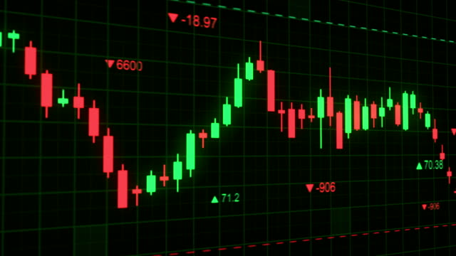
Introduction
Sentiment analysis is a tool for gauging the overall sentiment towards a company, product, or brand based on analysis of customer reviews
By analyzing language used in different tweets, we can determine whether sentiment towards a company is positive, negative, or neutral
Sentiment analysis can be used to determine whether to sell or buy stocks based on the overall perspective towards the stock market

Slide 4



Technologies Used
NLTK
01
02
Entity Recognition
Twitter
Python
Topic Modelling

Slide 5

Technologies Used
Twitter is a real-time platform where users share their thoughts and opinions about various topics, including companies and brands.
People tend to express their honest opinions on tweets, making it a valuable source for sentiment analysis
Sentiment analysis of tweets can provide a cost-effective and efficient way to gauge the overall sentiment towards a company or brand.
The immediacy of Twitter allows for real-time analysis, providing up-to-the-minute insights into the current sentiment towards a company or brand.

Slide 6

Technologies Used
Entity recognition in tweets can identify and extract important entities such as company names, stock tickers, and key financial indicators, allowing for targeted analysis.
By recognizing entities related to specific companies or industries, entity recognition can provide insights into the sentiment and discussions surrounding those entities in the market.
By analyzing the topics discussed in tweets, topic modeling can uncover emerging trends, market sentiments, and popular discussions, providing valuable insights into the state of the market.

Slide 7


Data
The dataset used is made of 5000 rows and 3 columns and the time range varies throughout the year 2020:
"id":This column contains unique identifiers for each tweet. The ID serves as a reference point to uniquely identify each tweet in our dataset.
"created_at": This column stores the timestamp indicating the exact date, time, and time zone offset when each tweet was published. The format of the timestamp follows the ISO 8601 standard, displaying the year (YYYY), month (MM), day (DD), hour (HH), minute (MM), second (SS), and the time zone offset from UTC (+00:00).
"text": This column contains the actual text of each tweet. It includes the content or message that users have posted.

Slide 8
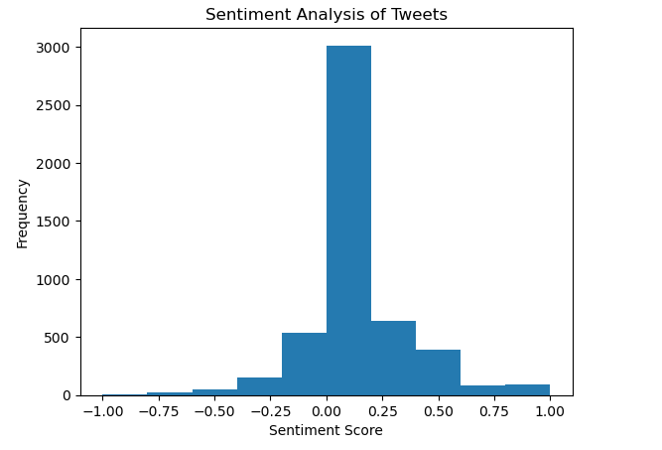
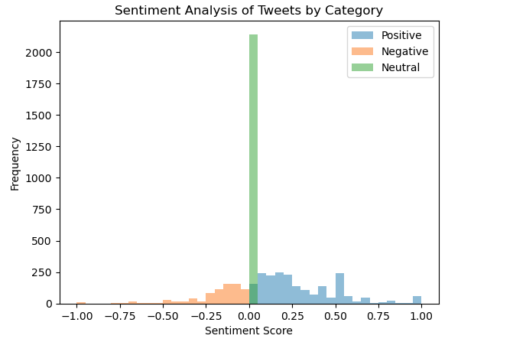
Sentiment Analysis Results
Average Sentiment Score: 0.10
During this period, we observed a more neutral sentiment in the tweets.

Slide 9
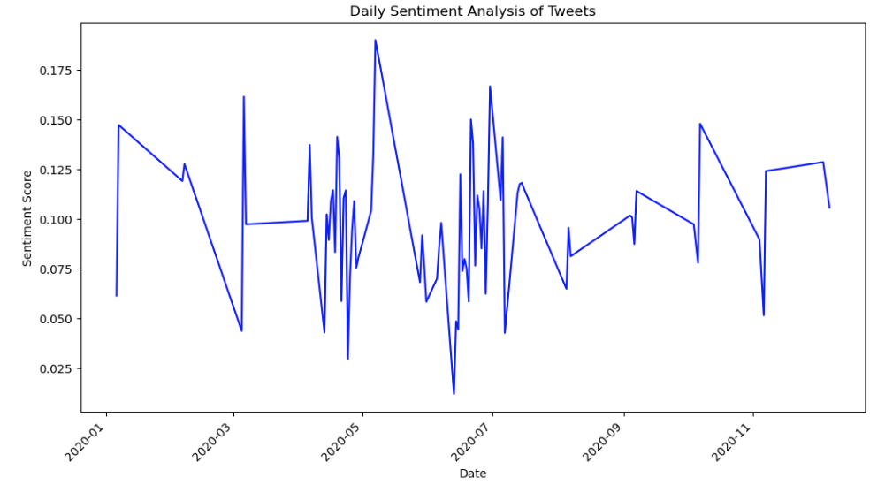
Sentiment Analysis Results- Time Series

Slide 10
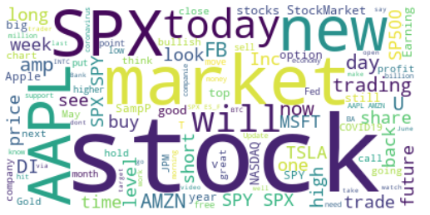
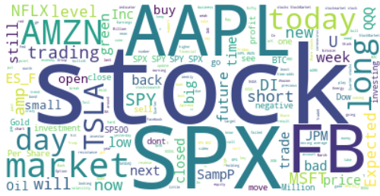
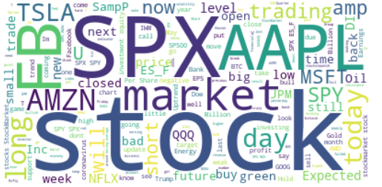
Sentiment Analysis Word Cloud
Total Data set
Positive Data set
Negative Data set
SPX and Apple are the most frequently mentioned words in the dataset.
Discussions around market performance.
The impact of COVID-19.
The rising uncertainty has prompted discussions about investing in gold.
Netflix and Amazon have become more relevant due to the lockdowns
Discussions about technology companies.
There is a bad perception about Facebook, Trump and JP morgan

Slide 11


Name Entity Recognition results
Positive
S&P 500
APPLE
AMAZON
MICROSOFT
Negative
S&P 500
JP Morgan
Pepsi
FED
The sentiment towards technology companies is generally positive.
On the other hand, banking and fast consuming sectors are viewed negatively.
The S&P 500 is mentioned in both positive and negative contexts, indicating its continued relevance.

Slide 12
Topic Modelling
Positive
Negative
Topic 0: Words related to futures trading and market trends.
Topic 1: Words related to investment, news, and stock market performance.
Topic 2: Words related to popular technology companies such as Apple, Amazon, and Google.
Topic 3: Words related to innovation and research and development in the technology industry.
Topic 4: Words related to market information and trends, with a focus on the NASDAQ.
Topic 5: Words related to Apple's stock performance, particularly in relation to new product releases.
Topic 6: Words related to earnings and performance of companies such as Johnson & Johnson, Goldman Sachs, and Wells Fargo.
Topic 7: Words related to Walt Disney World, including news about its cast members and union representation.
Topic 8: Words related to foreign exchange trading and trading strategies.
Topic 9: Words related to stock market trends and performance, including mentions of market capitalization and billionaire investors.
Topic 0: Discussion about stock market trends, with mixed sentiment. Mention of companies like Apple.
Topic 1: Discussion of earnings reports, expected results, and investment in various stocks.
Topic 2: Discussion of popular technology stocks like Facebook, Amazon, and Tesla.
Topic 3: Discussion of stock market indices like the S&P 500, Dow, and NASDAQ.
Topic 4: Discussion of short-term trades and price movements, including cryptocurrency.
Topic 5: Discussion of stock recommendations and analyst ratings for various companies.
Topic 6: Discussion of concerns about the suppression of dissenting voices and opinions on Facebook.
Topic 7: Discussion of quarterly earnings reports and sales figures for various companies.
Topic 8: Discussion of technical analysis and trading indicators for stock market investments.
Topic 9: Discussion of stock market trends and investments, including in the oil industry.

Slide 13



Conclusions
After analyzing the results, we have come to the following conclusions:
Technological companies have a positive perception, so it is recommended to maintain or buy stocks related to this market.
Facebook has a negative perception, so we do not recommend investing in this stock.
Due to the uncertain market, people are considering buying gold as a safe investment option.
Streaming and media companies such as Netflix, Amazon, and Disney are being discussed, and we recommend investing in these companies as well.

